Slide 1
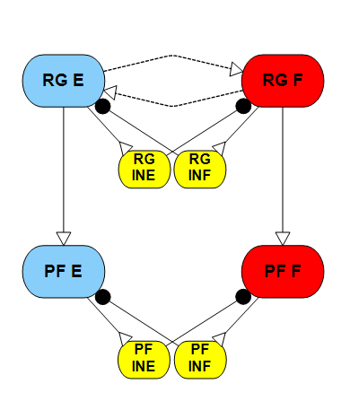
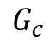
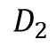
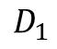
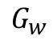
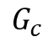
Parameters design for Two-layer CPG:
Inside CPG:
Between CPGs:
Frequency measurement
Phase plane
Steady state
Feedback sensitivity
Rhythm propagation
Phase shift
Feedback influence
$$D_{1}$$
$$G_{w}$$
$$G_{c}$$
$$G_{c}$$
$$D_{2}$$

Slide 2
Recall - Inside CPG :
0.743
3.5
5.23
If we want a desired frequency, say 1.5 Hz. The possible solutions are [Gw D] = [0 5.23]; [0.1 3.5]; [0.3 0.734]. However, the performance for different conductance is not the same. The phase plane size are smaller with large conductance.
Notes:
1: 0-1.5s
2: 2-4s 2nA

Slide 3
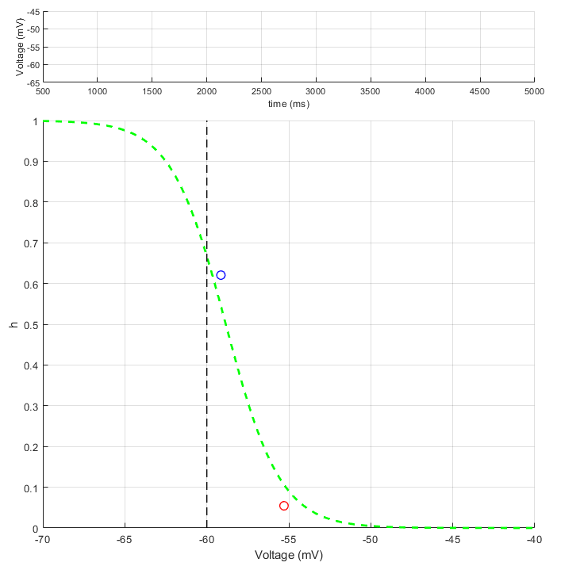
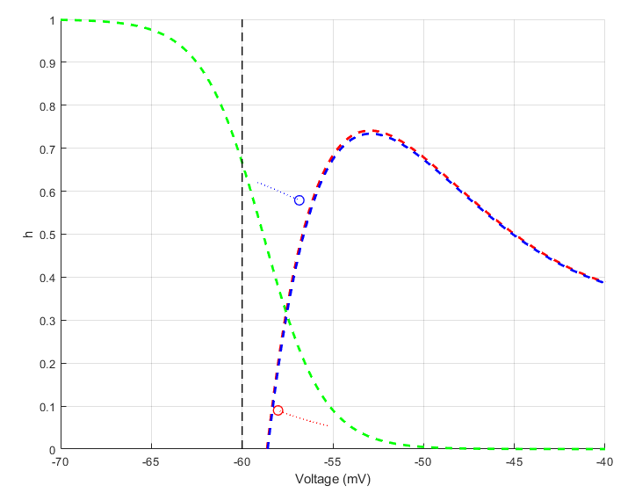
For the h-nullcline range, the problem is due to the reversal potential of h channel. As we increase the reversal channel, we now get the correct h-nullcline range.
Plot of voltage and phase plane over time
Phase plane with V-nullcline (0.5 speed)

Slide 4
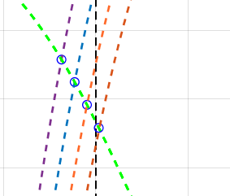
If the conductance between oscillators between oscillators is zero(classic half-center). Increasing the external drive will gradually push the lower end of steady state over threshold, generating oscillation.
h - nullcline
Threshold
D = 0
D = 2
D = 4
D = 6
For no external inputs condition, increasing the conductance between oscillators will also push the lower steady state over threshold, generating self-oscillation.
Gw = 0; increasing the drive
h - nullcline
Threshold
It seems increasing conductance have same effects as increasing external drive, both pushing inhibited neuron’s steady state over threshold, making the CPG oscillates, but the V-nullcline shows difference between this twos.
Gw = 0
Gw = 0.2
Gw = 0.4
Gw = 0.6
With no external drive, increase the Gw

Slide 5
Same steady state for two methods:
Note for the same inhibited steady state, the excited steady state for the two conditions are not the same. The frequency of oscillation is also different.
The external driving oscillation have lager isochron (oscillation magnitude of voltage), slower period than the self-oscillation situation.
h - nullcline
This difference makes me wondering what is the role of Gw, and does including a excitation connection between the oscillator makes the model more sensitive to feedbacks or external drives?
Threshold
Low – SS for pure drive
High – SS for pure drive
Low – SS for self-oscillates
High – SS for self-oscillates

Slide 6
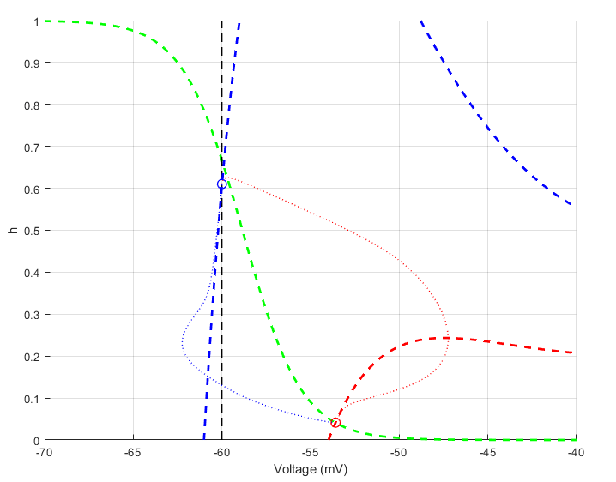
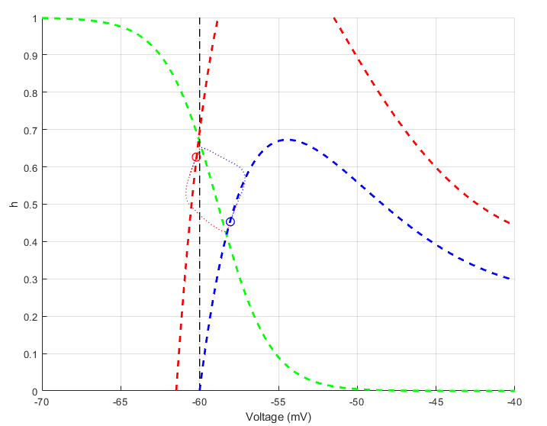
pure drive
self-oscillates

Slide 7
Comparing the steady state nullclines for 3 conditions:
Solid lines – pure drive (baseline)
Dot lines – self-oscillation (same frequency)
Dahs dot – self-oscillation (same inhibited steady state)
h - nullcline
Threshold
When compare both self-oscillation conditions, we found that the effects of Gw is pulling both steady state point to it’s center. (Gw for same frequency is lager than same inhibited steady state.)
Low – SS for pure drive
High – SS for pure drive
Low – SS for self-oscillates
High – SS for self-oscillates
Low – SS for self-oscillates
High – SS for self-oscillates

Slide 8
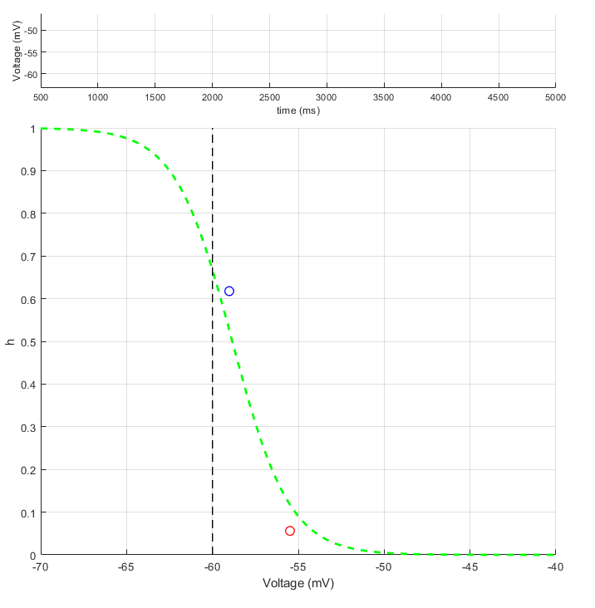
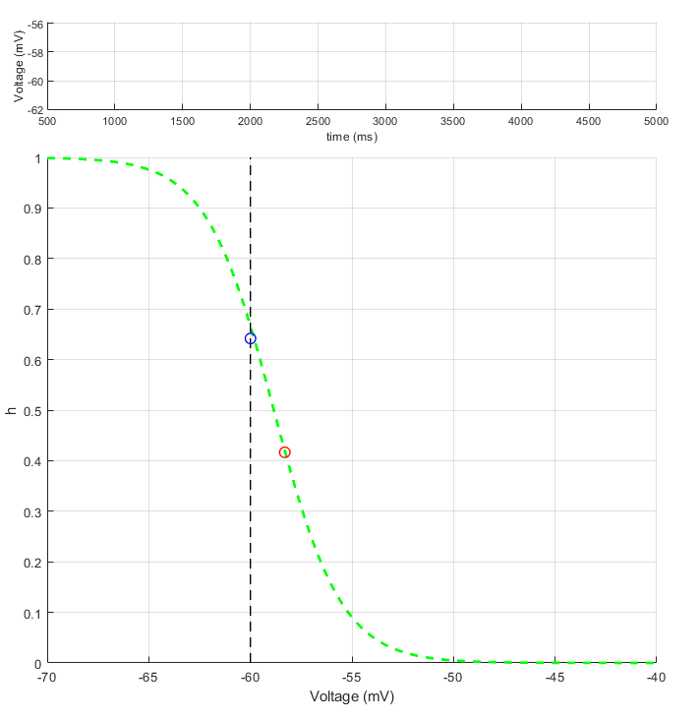
Small perturbation test:
Given same small stimulus to both oscillations (0.1 nA from 2s to 3s on extensor neuron), the results turns out the self- oscillating CPG is more affected by the stimulus. This is due to it’s small isochron, even the time to finishing one cycle is same.

Slide 9
Small perturbation test:
pure drive oscillation
Synaptic self-oscillation
Given the same small stimulus to both oscillations (0.1 nA for 1s) at different phase of it’s oscillation.
The stimulus prolong the activity duration during active phase of the oscillation and shorten the activity during silent phase for both cases.
However, for this investigation, the stimulus time is 1s which is longer than one phase duration. The prolongation for self-oscillation case is significate longer than pure drive cases while the shortening is similar.
Solid line stands for voltage for perturbed oscillation, dashed line is unperturbed.
X-axis is normalized phase of the period, the phase duration for both oscillation is 898 ms.

Slide 10
Short duration perturbation test:

Slide 11

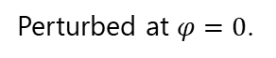



Normalized input of stimulus period in phase duration:
The amplitude of stimulus is 0.5 nA and the active time on extensor neuron is 10% phase duration on the pure drive case.
Perturbed at $φ=0$.
Perturbed at $φ=0$.25
Perturbed at $φ=0$.5
Perturbed at $φ=0$.75
For stimulus excites neuron with short period of time, the behavior of neuron activity is different with reports on previous studies, especially for $φ=0$.25 and $φ=0$.5, which suggests investigation for nullclines near those phases.

Slide 12


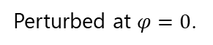
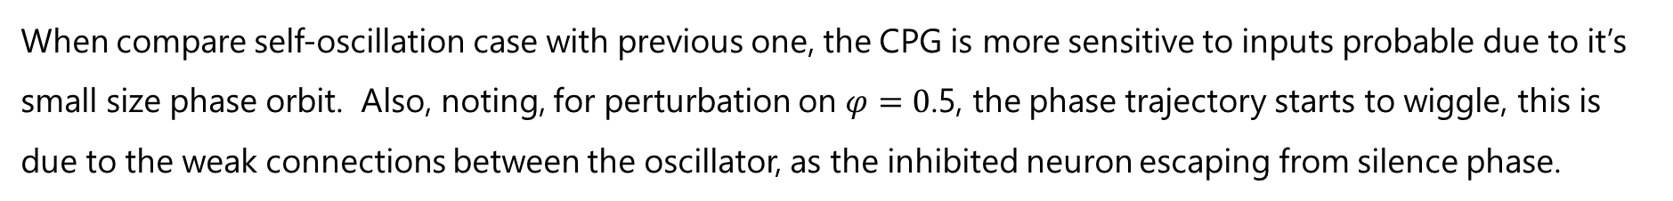
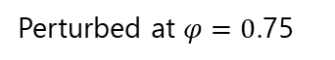
The amplitude of stimulus is 0.5 nA and active time on extensor neuron is 10% phase duration of self-oscillation.
Perturbed at $φ=0$.
Perturbed at $φ=0$.25
Perturbed at $φ=0$.5
Perturbed at $φ=0$.75
When compare self-oscillation case with previous one, the CPG is more sensitive to inputs probable due to it’s small size phase orbit. Also, noting, for perturbation on $φ=0$.5, the phase trajectory starts to wiggle, this is due to the weak connections between the oscillator, as the inhibited neuron escaping from silence phase.

Slide 13
Perturbed at $φ=0$.2, duration of 0.1 phase period, 0.5 nA.
The reason why the neuron activity for short duration of stimulus is different with previous report is while the active neuron’s V-nullcline did not change, the inhibited neurons developed a new V-nullcline, as the stimulus been removed, the inhibited neuron jump over threshold immediately.

Slide 14
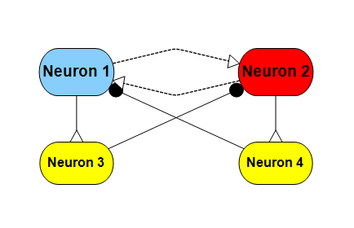
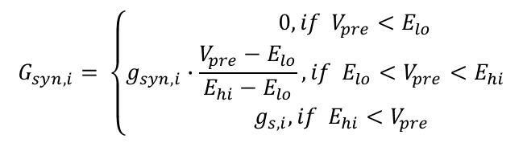
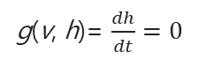
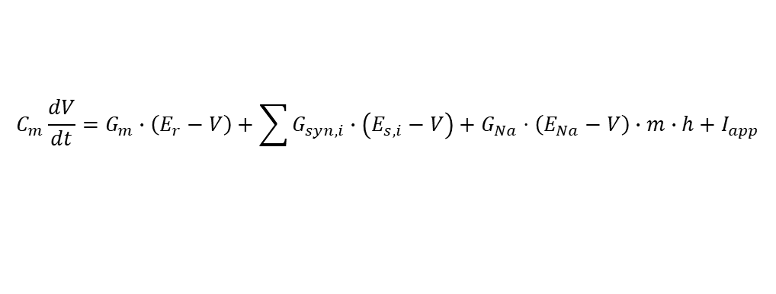
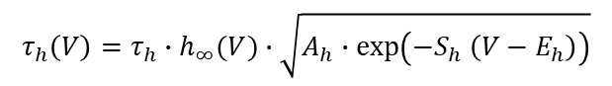
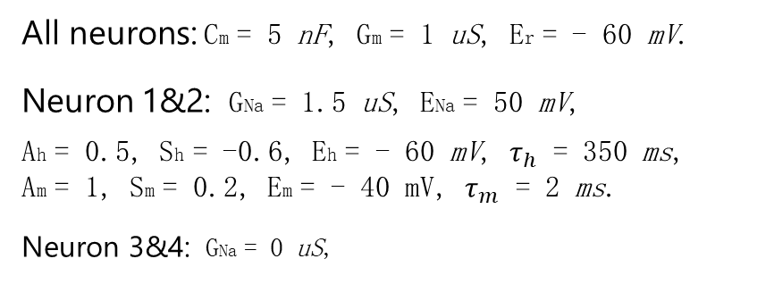
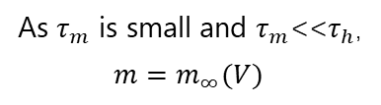
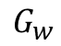
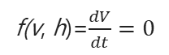
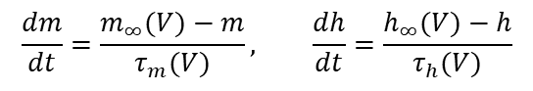
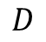
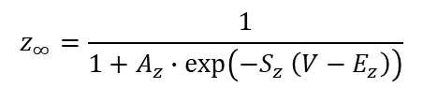
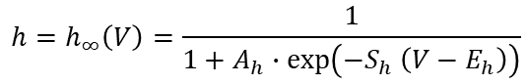
Mathematic Analysis:
$$D$$
General equations:
$$G_{w}$$
$$C_{m}\frac{dV}{dt}=G_{m}∙\left(E_{r}−V\right)+\sum{G_{syn,i}∙\left(E_{s,i}−V\right)}+G_{Na}⋅\left(E_{Na}−V\right)∙m∙h+I_{app}$$
$$G_{syn,i}= \left\{\begin{matrix} 0, if V_{pre}<E_{lo} \\ g_{syn,i}∙\frac{V_{pre}−E_{lo}}{E_{hi}−E_{lo}}, if E_{lo}<V_{pre}<E_{hi} \\ { g}_{s,i}, if E_{hi}<V_{pre}\end{matrix}\right.$$
All neurons: Cm = 5 nF, Gm = 1 uS, Er = - 60 mV.
Neuron 1&2: GNa = 1.5 uS, ENa = 50 mV,
Ah = 0.5, Sh = -0.6, Eh = - 60 mV, $τ_{h}$ = 350 ms,
Am = 1, Sm = 0.2, Em = - 40 mV, $τ_{m}$ = 2 ms.
Neuron 3&4: GNa = 0 uS,
$$\frac{dm}{dt}=\frac{m_{∞}(V)−m}{τ_{m}(V)}, \frac{dh}{dt}=\frac{h_{∞}(V)−h}{τ_{h}(V)}$$
As $τ_{m}$ is small and $τ_{m}$<<$τ_{h}$,
$${m=m}_{∞}(V)$$
$$z_{∞}=\frac{1}{1+A_{z}∙exp⁡\left({−S}_{z} \left(V−E_{z}\right)\right)}$$
$$τ_{h}\left(V\right)=τ_{h}∙h_{∞}(V)∙\sqrt{A_{h}∙exp⁡\left({−S}_{h} \left(V−E_{h}\right)\right)}$$
The h-nullcline is the collection of (v, h) points where g(v, h)=0:
g(v, h)= $\frac{dh}{dt}=0$
$$h=h_{∞}\left(V\right)=\frac{1}{1+A_{h}∙exp⁡\left({−S}_{h} \left(V−E_{h}\right)\right)}$$
All synapse: Elo = -60 mV, Ehi = - 40 mV.
Synapse 1->3 & 2->4: gSyn = 2 nF Es = - 40 mV.
Synapse 3->2 & 4->1: gSyn = 2 nF Es = - 70 mV
Synapse 1->2 & 2->1: gSyn = Gw Es = - 40 mV
The v-nullcline is the collection of (v, h) points where f(v, h)=0:
f(v, h)=$\frac{dV}{dt}=0$
$$h=\left(1+A_{m}∙exp⁡\left({−S}_{m} \left(V−E_{m}\right)\right)\right)∙\frac{G_{m}∙\left(E_{r}−V\right)+\sum{G_{syn,i}∙\left(E_{s,i}−V\right)+I_{app}}}{G_{Na}⋅\left(E_{Na}−V\right)}$$

Slide 15
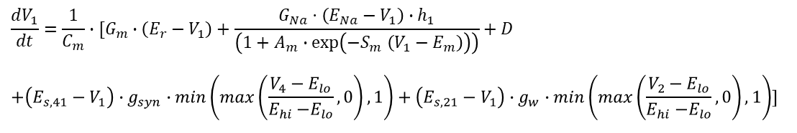
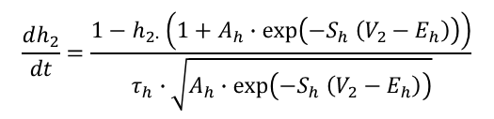
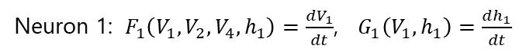
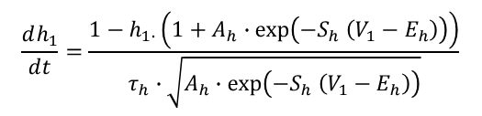
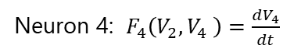
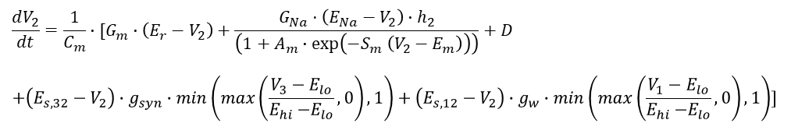
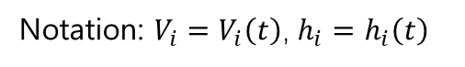
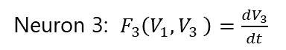
Neuron 1: $F_{1}\left(V_{1},V_{2},V_{4},h_{1}\right)=\frac{dV_{1}}{dt}$, $G_{1}\left(V_{1},h_{1}\right)=\frac{dh_{1}}{dt}$
Notation: $V_{i}=V_{i}\left(t\right)$, $h_{i}=h_{i}\left(t\right)$
$$D$$
$$\frac{dV_{1}}{dt}=\frac{1}{C_{m}}∙[G_{m}∙\left(E_{r}−V_{1}\right)+\frac{G_{Na}⋅\left(E_{Na}−V_{1}\right)∙h_{1}}{\left(1+A_{m}∙\exp\left({−S}_{m} \left(V_{1}−E_{m}\right)\right)\right)}+D$$
$$+\left(E_{s,41}−V_{1}\right)∙g_{syn}∙min\left(max\left(\frac{V_{4}−E_{lo}}{E_{hi}{−E}_{lo}},0\right),1\right)+\left(E_{s,21}−V_{1}\right)∙g_{w}∙min\left(max\left(\frac{V_{2}−E_{lo}}{E_{hi}{−E}_{lo}},0\right),1\right)]$$
$$G_{w}$$
$$\frac{dh_{1}}{dt}=\frac{1−h_{1∙}\left(1+A_{h}∙exp⁡\left({−S}_{h} \left(V_{1}−E_{h}\right)\right)\right)}{τ_{h}∙\sqrt{A_{h}∙exp⁡\left({−S}_{h} \left(V_{1}−E_{h}\right)\right)}}$$
Neuron 2: $F_{2}\left(V_{1},V_{2},V_{3},h_{2}\right)=\frac{dV_{2}}{dt}$, $G_{2}\left(V_{2},h_{2}\right)=\frac{dh_{2}}{dt}$
All neurons: Cm = 5 nF, Gm = 1 uS, Er = - 60 mV.
Neuron 1&2: GNa = 1.5 uS, ENa = 50 mV,
Ah = 0.5, Sh = -0.6, Eh = - 60 mV, $τ_{h}$ = 350 ms,
Am = 1, Sm = 0.2, Em = - 40 mV, $τ_{m}$ = 2 ms.
Neuron 3&4: GNa = 0 uS,
$$\frac{dV_{2}}{dt}=\frac{1}{C_{m}}∙[G_{m}∙\left(E_{r}−V_{2}\right)+\frac{G_{Na}⋅\left(E_{Na}−V_{2}\right)∙h_{2}}{\left(1+A_{m}∙\exp\left({−S}_{m} \left(V_{2}−E_{m}\right)\right)\right)}+D$$
$$+\left(E_{s,32}−V_{2}\right)∙g_{syn}∙min\left(max\left(\frac{V_{3}−E_{lo}}{E_{hi}{−E}_{lo}},0\right),1\right)+\left(E_{s, 12}−V_{2}\right)∙g_{w}∙min\left(max\left(\frac{V_{1}−E_{lo}}{E_{hi}{−E}_{lo}},0\right),1\right)]$$
$$\frac{dh_{2}}{dt}=\frac{1−h_{2∙}\left(1+A_{h}∙exp⁡\left({−S}_{h} \left(V_{2}−E_{h}\right)\right)\right)}{τ_{h}∙\sqrt{A_{h}∙exp⁡\left({−S}_{h} \left(V_{2}−E_{h}\right)\right)}}$$
All synapse: Elo = -60 mV, Ehi = - 40 mV.
Synapse 1->3 & 2->4: gSyn = 2 nF Es = - 40 mV.
Synapse 3->2 & 4->1: gSyn = 2 nF Es = - 70 mV
Synapse 1->2 & 2->1: gSyn = Gw Es = - 40 mV
Neuron 3: $F_{3}\left(V_{1},V_{3} \right)=\frac{dV_{3}}{dt}$
$\frac{dV_{3}}{dt}=\frac{1}{C_{m}}∙[G_{m}∙\left(E_{r}−V_{3}\right)+\left(E_{s,13}−V_{3}\right)∙g_{syn}∙min\left(max\left(\frac{V_{1}−E_{lo}}{E_{hi}{−E}_{lo}},0\right),1\right)$]
Neuron 4: $F_{4}\left(V_{2},V_{4} \right)=\frac{dV_{4}}{dt}$
$\frac{dV_{4}}{dt}=\frac{1}{C_{m}}∙[G_{m}∙\left(E_{r}−V_{4}\right)+\left(E_{s,24}−V_{4}\right)∙g_{syn}∙min\left(max\left(\frac{V_{2}−E_{lo}}{E_{hi}{−E}_{lo}},0\right),1\right)$]

Slide 16
A.
B.

Slide 17
A.
B.

